Slide 1
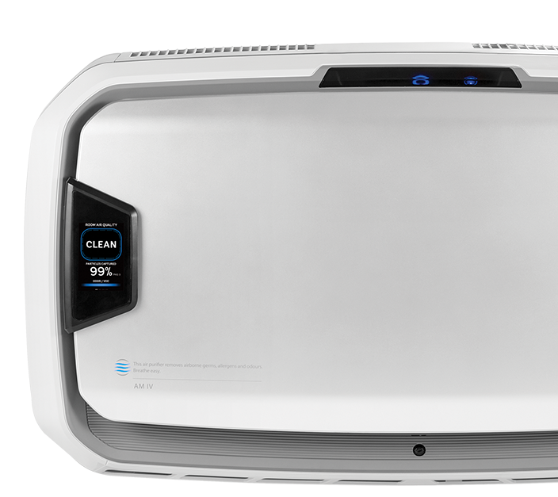
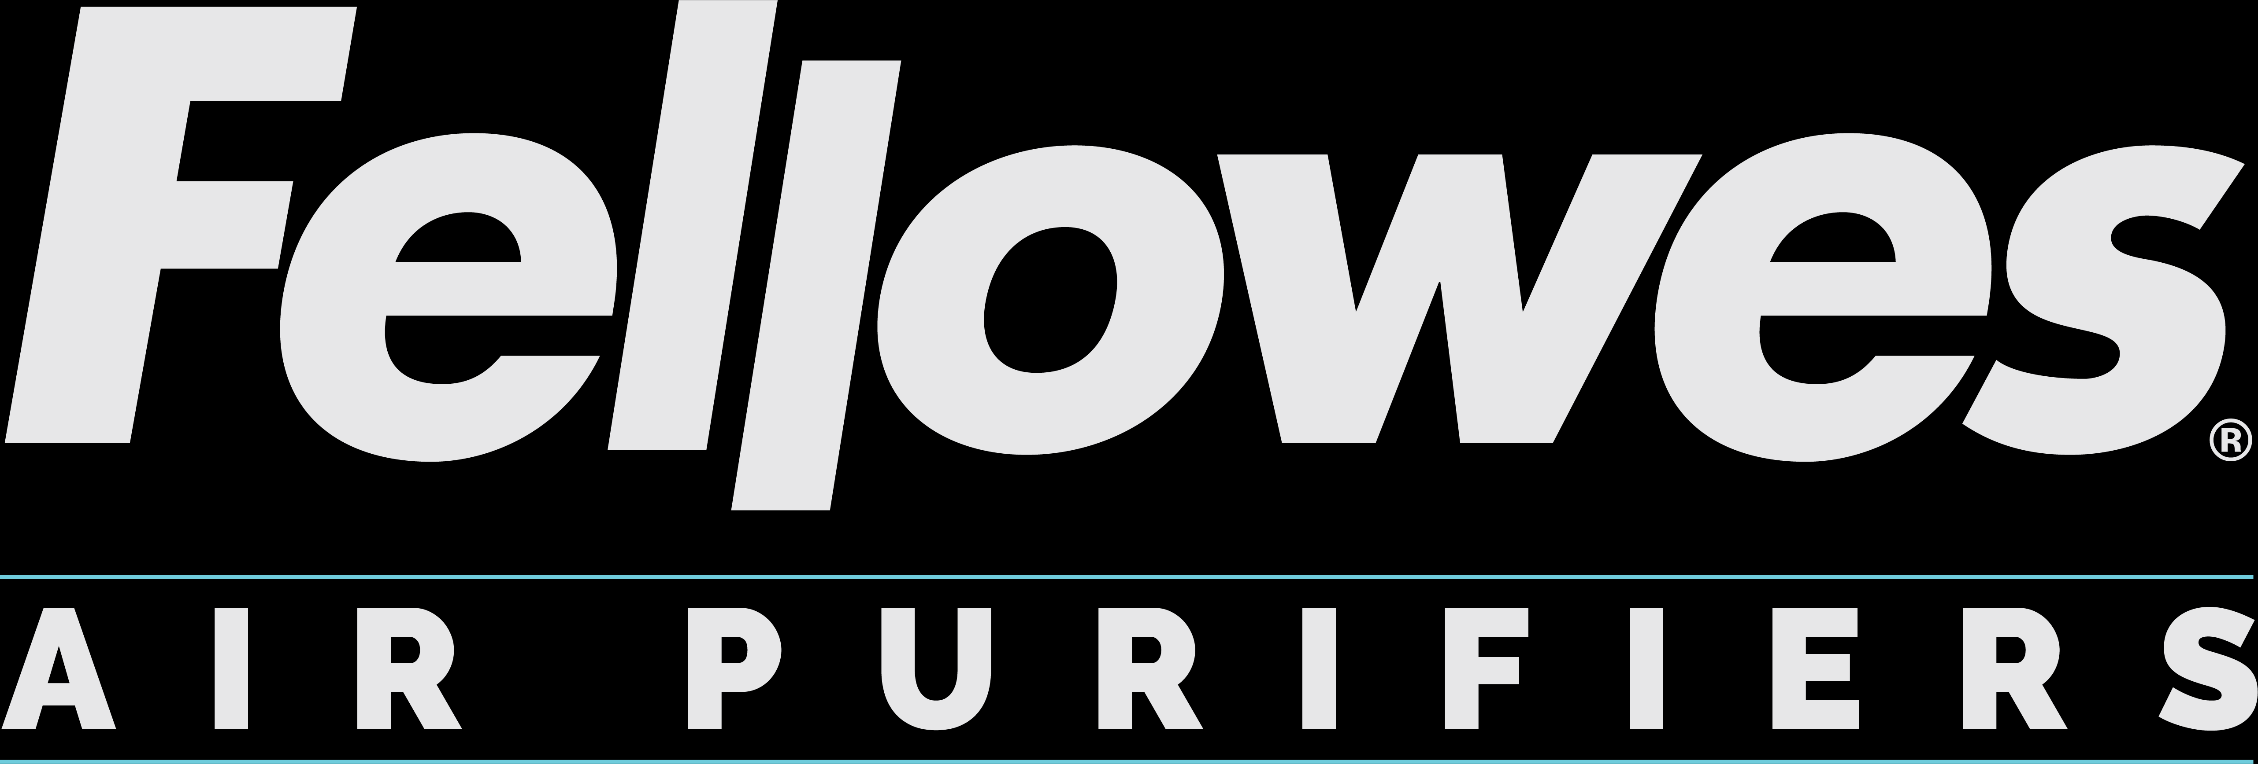
Coronavirus Testing
Test Results Summary
March 2021
Branding Concepts

Slide 2
Coronavirus Testing Summary
Fellowes partnered with an independent and accredited laboratory to analyze the airborne reduction of coronavirus 229E when using Fellowes AeraMax Pro Air Purifiers
5 tests were done using a combination of AeraMax Pro AM2, AM3 and AM4 models
Testing was conducted using a surrogate coronavirus (Human Coronavirus 229E)
This was aerosolized in a 20m³ test chamber (similar to our H1N1 testing)
Samples were collected and analyzed after a 1 hour period
The full test methodology is available along with test reports from the lab

Slide 3
Test Results
HCoV 229E Killing Rate Test
NO# | Model | Filters | Antiviral Activity Rate（%） | Report file | Test Reference Specification
1 | AM2 | Hybrid Filter | 99.99%/1H | WP-20116865-JC-01En | Technical specification for disinfection(2002)
2 | AM3/S PC | Pre-filter+Carbon filter+HEPA filter | 99.99%/1H | WP-20116865-JC-02En
3 | AM3/S PC | Pre-filter+Hybrid Filter | 99.99%/1H | WP-20116865-JC-03En
4 | AM4/S PC | Pre-filter+Carbon filter+HEPA filter | 99.99%/1H | WP-20116865-JC-04En
5 | AM4/S PC | Pre-filter+Hybrid Filter | 99.99%/1H | WP-20116865-JC-05En
The above is a summary of all 5 test reports. Where we are asked to provide evidence, the PDF reports are available.

Slide 4
Claim Statement
Fellowes AeraMax Pro Air Purifiers were demonstrated to be effective in reducing aerosolized airborne concentration of Human Coronavirus 229E in a test chamber reaching 99.99% airborne reduction within 1 hour of operation*.
* Based on Independent Laboratory Testing.

Slide 5
Claim Statement
Fellowes AeraMax PRO Air Purifiers were demonstrated to be effective in reducing aerosolized airborne concentration of Human Coronavirus 229E in a test chamber reaching 99.99% airborne reduction within 1 hour of operation*.
* Based on Independent Laboratory Testing.
Separate Machine Claims
The Fellowes AeraMax PRO AM 2 Air Purifier was demonstrated to be effective in reducing aerosolized airborne concentration of Human Coronavirus 229E in a test chamber reaching 99.99% airborne reduction within 1 hour of operation*.
The Fellowes AeraMax PRO AM 3 Air Purifier was demonstrated to be effective in reducing aerosolized airborne concentration of Human
Coronavirus 229E in a test chamber reaching 99.99% airborne reduction within 1 hour of operation*.
The Fellowes AeraMax PRO AM 4 Air Purifier was demonstrated to be effective in reducing aerosolized airborne concentration of Human Coronavirus 229E in a test chamber reaching 99.99% airborne reduction within 1 hour of operation*.
* Based on Independent Laboratory Testing.

Slide 6
Testing FAQs
What is 229E and why did we use it?
It causes the common cold, but it has similar characteristics. Enveloped, positive-sense single-stranded RNA virus which is how Sars-CoV-2 is described. (CDC LINK)
About the size comparison, “Under the electron microscope, coronavirus virions are spherical or pleomorphic. Coronavirus particles are enveloped, about 80–120 nm in diameter” (source: https://www.ncbi.nlm.nih.gov/pmc/articles/PMC7204879/)
Why did we not use Sars-CoV-2?
It is not yet possible for labs to aerosolize Sars-CoV-2 for airborne testing. Some manufacturers are using a surface approach to test against Sars-CoV-2 such as ionization companies, but we have not seen anyone yet make this airborne. Labs are still telling us this is not ethical or possible in the current climate.
Can we claim we capture COVID-19?
No. Without specific testing using the actual virus strain, we cannot make a direct COVID-19 claim.
Where was the testing conducted?
The testing was done in an independent and certified facility in Shanghai (WEIPU).
The lab has multiple accreditations and certifications including CNAS and CMA.
CNAS demonstrates that the lab is accredited in accordance with ISO/IEC 17025. “ISO/IEC 17025 enables laboratories to demonstrate that they operate competently and generate valid results, thereby promoting confidence in their work both nationally and around the world.” (Source: ISO.org)
The lab works with multiple international clients such as Bayer, BASF, Unilever and 3M.
Why is the claim after 1 hour?
The reason the claim is after 1 hour is because this was the pre-agreed period of time left between baseline measurement and removal measurement. This doesn’t mean it took the full hour, but within the 1 hour period the airborne level was reduced by 99.99%
Notes:
Virus comparison visuals
https://www.sciencedirect.com/science/article/pii/S2590093520300175

Slide 7
Test Methodology
Take the test virus suspension, filter it with sterile absorbent cotton, and dilute it with nutrient broth medium to the required concentration.
Simultaneously adjust the temperature and relative humidity of the two aerosol chambers to the temperature and relative humidity required by the test.
Put the air purifier into the aerosol chamber and close the door. After this stage, all operations and the control of instruments and equipment are performed outside the chamber through a window with a sealed sleeve or a remote control. Until the end of the test, the door will not be opened.
Spray the ‘contaminant’ according to the set pressure, gas flow and spray time. While spraying the contaminant, stir with a fan. After spraying the virus, continue to stir for 5 minutes, and then stand for 5 minutes.
At the same time, the control group and test group aerosol chamber were sampled before disinfection, as a positive control before the start of the control group experiment and the disinfection treatment of the experimental group.
The number of positive control virus in the air in the aerosol cabinet (or room) should reach 5×104 cfu/m³ ~ 5×106 cfu/m³.
Notes:
Fellowes has partnered with an independent and accredited laboratory to analyze the airborne reduction of coronavirus 229E when using Fellowes AeraMax Professional Air Purifiers

Slide 8
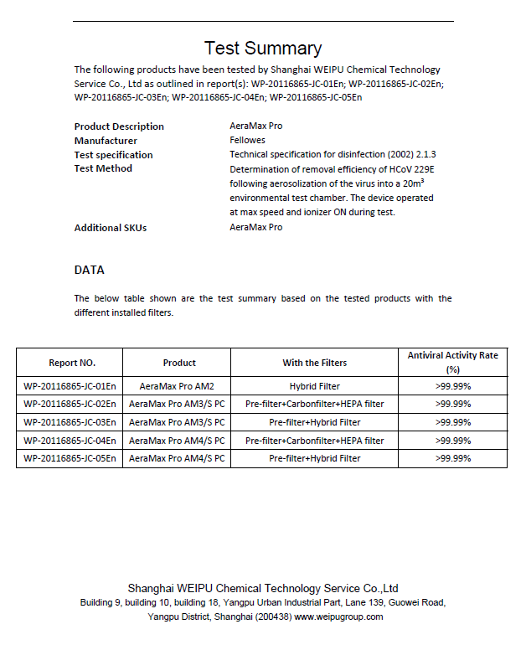
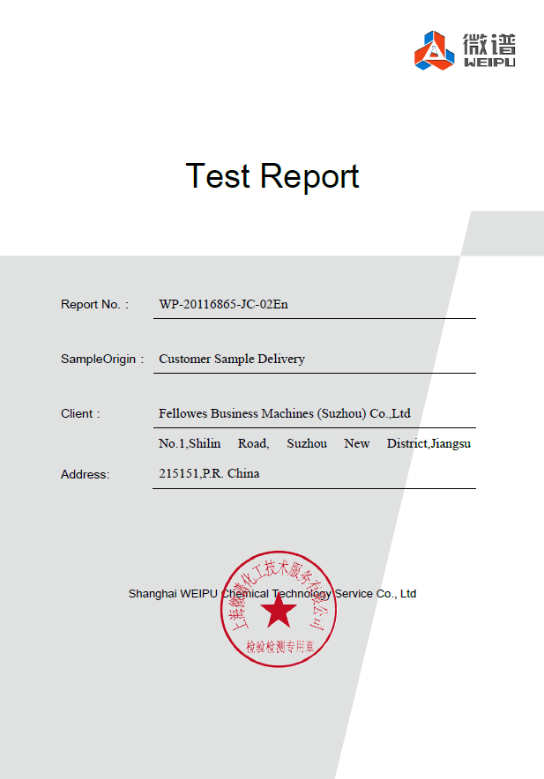
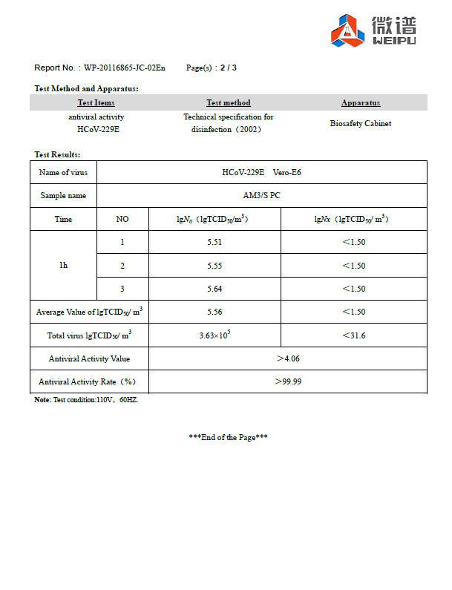
1-page Testing Summary
Our Test Reports
5 Single Machine Test Reports

Slide 9
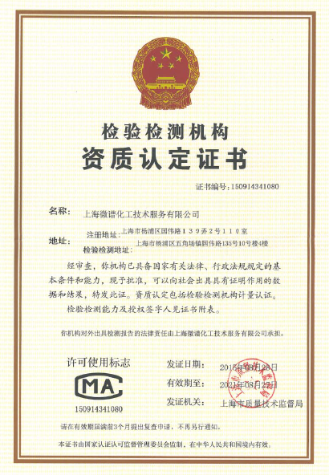
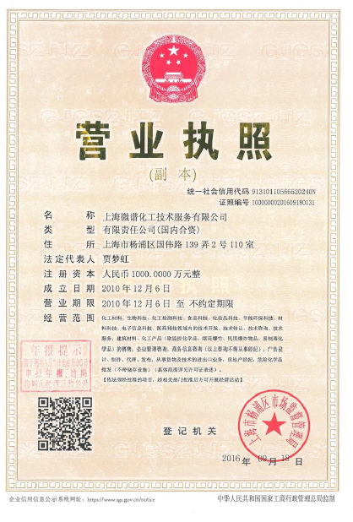
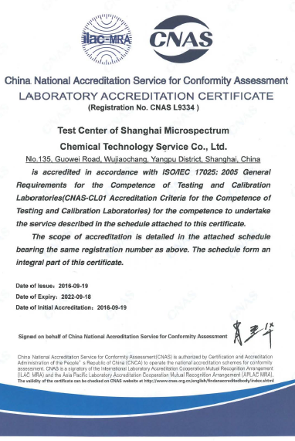

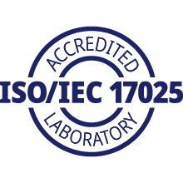
Laboratory Accreditations
“ISO/IEC 17025 enables laboratories to demonstrate that they operate competently and generate valid results, thereby promoting confidence in their work both nationally and around the world.”
https://www.iso.org/ISO-IEC-17025-testing-and-calibration-laboratories.html

