Slide 1
OMRON Cuff Compatibility
Current SF Range – as of 2025
Please reach out via the Info_Omronhealthcare_UK@omron.com for any further queries

Slide 2
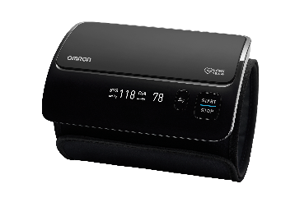
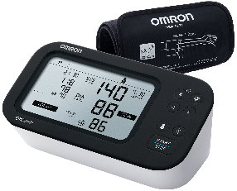
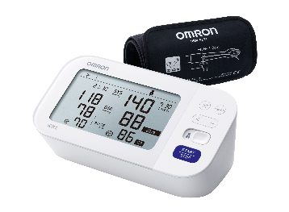
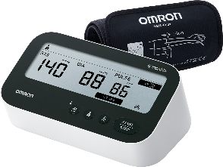
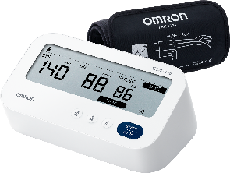
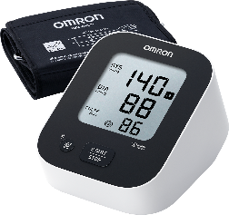
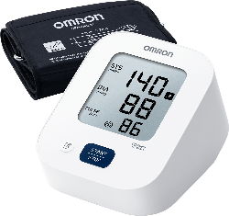
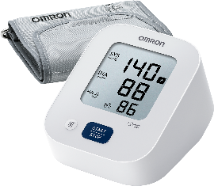
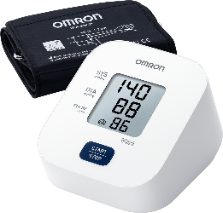
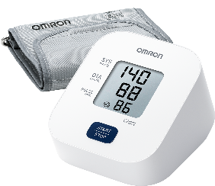
ECG
Blood Pressure Monitoring
Respiratory Therapy
Pain Management
Weight Management
Temperature Measurement
Compare products
Upper arm home-use blood pressure monitors
Model | EVOLV | M7 Intelli IT AFib | M6 Comfort AFib | M4 Connect AFib | M3 Comfort AFib | M2+ Connect | M2+ | M2 Essential | M1 Basic (L cuff) | M1 Basic
Product Code | HEM-7600T-E | HEM-7380T1-EBK | HEM-7380-E | HEM-7196T1-FLE | HEM-7196-FLE | HEM-7188T1-LE | HEM-7188-LE | HEM-7188-E | HEM-7090-LE | HEM-7090-E
All in One No tubes. No wires. Simply accurate. | ● | ● | ● | ● | ● | ● | ● | ● | ● | ●
Intelli Wrap Cuff Technology Accurate results in any position around the upper arm | ● | ● | ● | ● | ● | ● | ● | ● | ● | ●
OMRON connect | ● | ● | ● | ● | ● | ● |  | ● | ● | ●
Intellisense Technology Measurement without unnecessary over-inflation of the cuff | ● | ● | ● | ● | ● | ● | ● | ● | ● | ●
Atrial Fibrillation Indicator |  | ● | ● | ● | ● | ● | ● | ● | ● | ●
3x Measurement Function | ● | ● | ● | ● | ● | ● | ● | ● | ● | ●
Comparison Function | ● | ● | ● | ● | ● | ● | ● | ● | ● | ●
Irregular Heartbeat Detection | ● | ● | ● | ● | ● | ● | ● | ● | ● | ●
Blood Pressure Indicator | ● | ● | ● | ● | ● | ● | ● | ● | ● | ●
Body Movement Detection Signals if excessive movement detected during measurement | ● | ● | ● | ● | ● | ● | ● | ● | ● | ●
Cuff Wrap Guide Supports accurate measurement | ● | ● | ● | ● | ● | ● | ● | ● | ● | ●
Cuff - Type & Size | Intelli Wrap Cuff (Preformed) 22-42 cm | Intelli Wrap Cuff (Preformed) 22-42 cm | Intelli Wrap Cuff (Preformed) 22-42 cm | Intelli Wrap Cuff (Preformed) 22-42 cm | Intelli Wrap Cuff (Preformed) 22-42 cm | Medium/Large Cuff 22-42 cm | Medium/Large Cuff 22-42 cm | Medium Cuff 22-32 cm | Medium/Large Cuff 22-42 cm | Medium Cuff 22-32 cm
Optional Cuff |  |  |  |  |  | Small Arm Cuff 17-22 cm | Small Arm Cuff 17-22 cm | Small Arm Cuff 17-22 cm Medium/Large Cuff 22-42 cm | Small Arm Cuff 17-22 cm | Small Arm Cuff 17-22 cm Medium/Large Cuff 22-42 cm
Memory Capacity | 1 user x 100 | 2 users x 100 | 2 users x 100 | 2 users x 60 | 2 users x 60 | 1 user x 30 | 1 user x 30 | 1 user x 30 | Last measurement | Last measurement
Power Source | 4 “AA” batteries | 4 “AA” batteries or optional AC adapter | 4 “AA” batteries or optional AC adapter | 4 “AA” batteries or optional AC adapter | 4 “AA” batteries or optional AC adapter | 4 “AA” batteries or optional AC adapter | 4 “AA” batteries or optional AC adapter | 4 “AA” batteries or optional AC adapter | 4 “AA” batteries | 4 “AA” batteries
Storage Case Included | yes | yes | yes | yes | yes
* When used with the OMRON connect app, previous readings can be stored without limits.

